Slide 1

Forecasting Air Quality of Boston
Hande Gulbagci Dede
Mentor: Ajith Patnaik
Photo by Robin Lubbock

Slide 2
Air Pollution
Contamination of the environment by any physical, chemical, or biological agent changes the atmosphere's natural characteristics.
The Air Quality Index, the concentration of pollutants in the air in a specific place, is accepted as an indicator of air pollution.

Slide 3
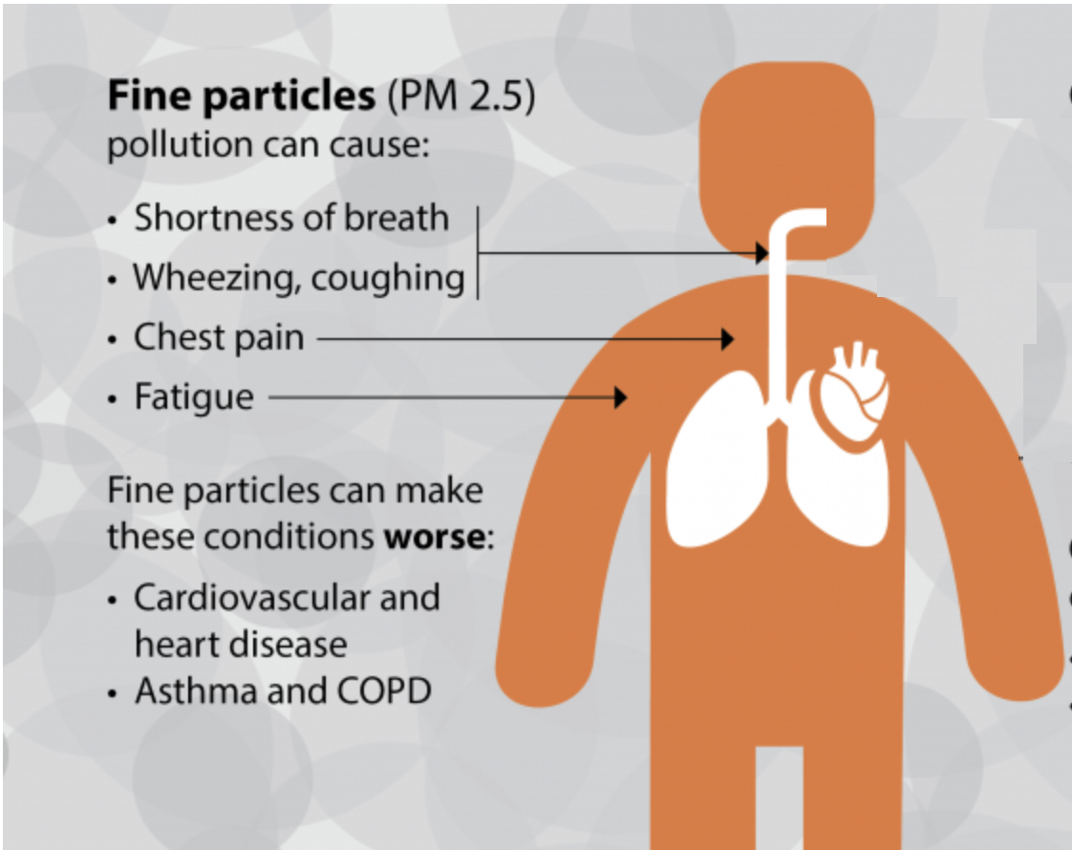
Problem
Air pollution can cause both
short-term and long-term effects.

Slide 4
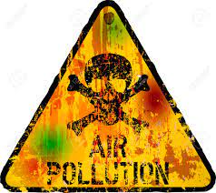
Importance of Air Pollution Forecasting
To reduce the damage caused by air pollution to human health.
By forecasting air quality, authorities
can take precautions and
issue early warnings
Aim: Forecasting the air quality of Boston, the capital and largest city in Massachusetts in the USA, for 2023.

Slide 5
Data Information
1
Daily average air quality of Boston Station
Source: Quality Historical Data Platform
Parameters: PM25, O3, NO2, SO2, and CO.
Air Quality Data
2
Weather
The weather can significantly impact air quality
Source: visialcrossing.com
33 attributes (temperature, humidity, wind, etc.)
3
Energy Consumption
Source: US Energy Information Administration
The natural gas delivered to consumers and total gasoline all sales in Massachusetts
4
Flight Number and Population
Each month's total airport flight number (domestic and international)
Source: Boston Logan International Airport
5
Federal Highway Administration's Reports
Source: Office of Highway Policy
Estimated travel on all roads and streets in Massachusetts and the amount of gallons taxed

Slide 6
Data Information
Air pollution indicator: PM_{2.5}
Tiny particles of solid or liquid suspended in a gas.
2.5 refers to the diameter of particles which is 2.5 microns or less.
Since being smaller they can transferred to longer distances.
Data period: From 2014 January to 2021 December
A total of 33 attributes

Slide 7
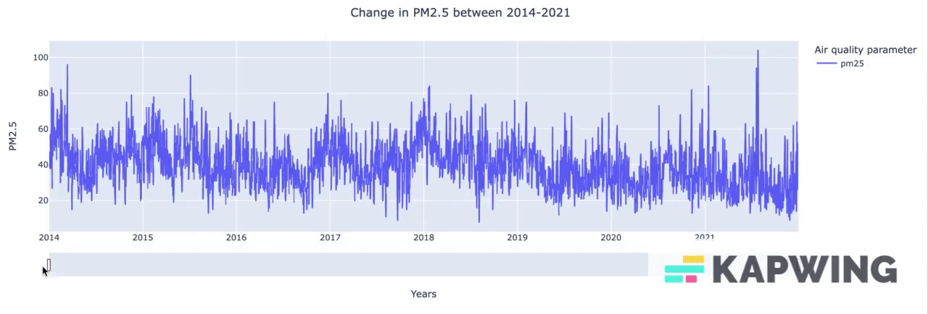
Changes in PM_{2.5} between 2014 and 2021

Slide 8
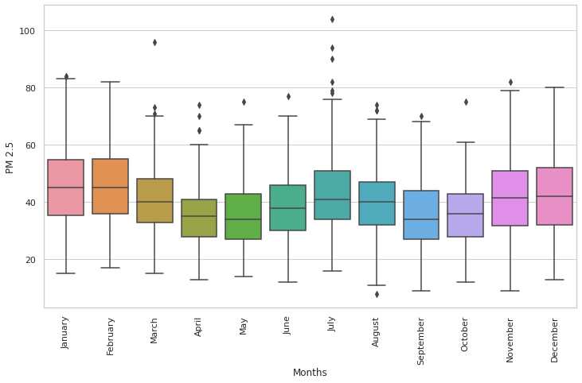
Monthly Average of PM_{2.5}
Increase in summer
-JULY-
Decrease in spring and fall

Slide 9
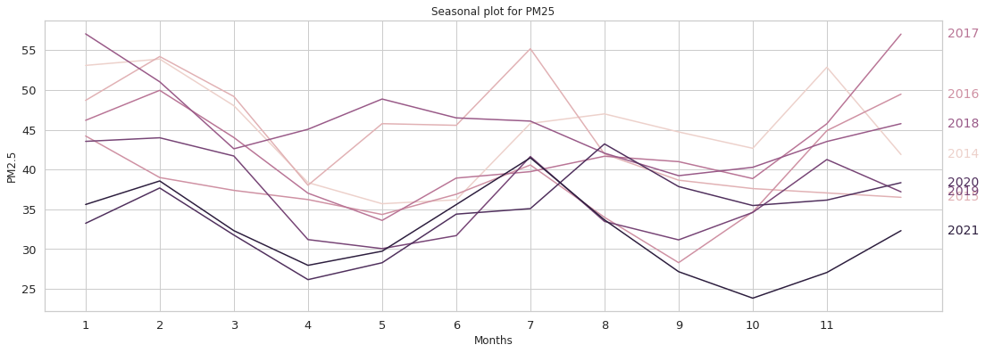
Seasonal Plot of PM_{2.5}

Slide 10
Modeling Overview
I tested univariate time series models:
Naive, Seasonal Naive, Simple Average as simple methods
Simple Exponential Smoothing, Holt-Winters,
ARMA, ARIMA, SARIMA,
FbProphet,
PyCaret
LSTM.
Cross-validation and hypermeter tuning

Slide 11
Modeling Overview
Feature Selection for exogenous variables
Random Forest Regression,
Stepwise Regression - Backwards elimination approach.
Multivariate time series models:
ARIMAX,
SARIMAX,
FbProphet,
PyCaret

Slide 12
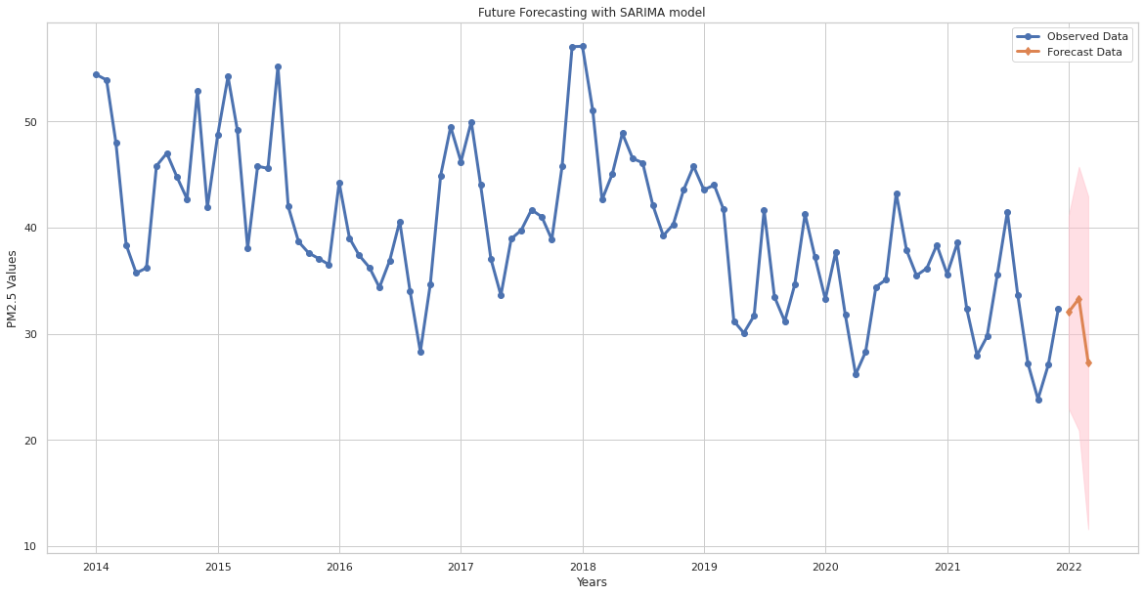
Forecasting
Forecasting PM_{2.5} values in 3 months of 2022 with SARIMA Model

Slide 13
Future Improvements
Using observed data of January, February, and March of 2022 for assessing performance of champion and challenger models.
Univariate performed better than multivariate models. Some exogenous features were not statistically significant.
Examine different features such as wildfires and vehicle/human mobility
Predicting air quality for smaller areas
Gathering data from stations much closer to each other.

Slide 14
Thank you
Hande Gulbagci Dede
e-mail: handeguldede@gmail.com
Github: https://github.com/hangulde
Photo by Robin Lubbock

